Slide 1
Exploring Hotels in Toronto, Ont, Canada. (Using Foursquare API)
Prepared By: Simon Mafany E
June 2019

Slide 2
AGENDA
Introduction & Background Info
(Project description / Target)
Data Description and Sourcing
Methodology
Results & Discussion
Conclusion

Slide 3
INTRODUCTION
BACKGROUND
Every business dreams of growing big and expanding its roots to have not greater competition advantage and large share of the market.
XYZ corporation (Hotel & Leisure) has been operating effectively in 5 large cities in Canada (Montreal, Calgary, Edmonton, Gatineau, and Quebec). With the objective of dominating the hospitality and leisure industry, they have decided to expand their brand by investing on another project in setting up a business line in Toronto.

Slide 4
BACKGROUND CONTINUES…
Deciding on the exact location to set the structure is a major problem. With everything being equally, XYZ Corporation has some preliminary reservations on where to set up structures taking into consideration the soundings and environmental friendly factors.
They prefer to set up their structures near or closely beside touristic endowments, less competitive and averagely dense areas. XYZ wishes to have at least 3 options from which a best choice would be made.
How can we know which location is best to set up structures, considering our reservations and policies?
Any person/Organization who is willing to set up a new hotel in Toronto, Canada can the implementation in this project to get the best location for establishment.

Slide 5
DATA DESCRIPTION & SOURCING
We shall be using datasets sourced from a wikipedia page which provides good information and a list of neighborhoods with associated postal codes in Toronto.
The data is in table format with 3 attributes (Postcode, Borough and Neighborhood) and 103 distinct records or postal codes.
The Second dataset is a CSV file Which has 3 attributes **(Postcode, Longitude, Latitude coordinates)** and 103 records.
Merging these two datasets base on their Postcodes. The final dataset would contain 5 attributes and 103 records.
Use Foursquare API To get list of different venues(hotels) in the Toronto neighborhood and different Venues.(location data)

Slide 6
Data Sources and Acquisition
Data would be acquired using :
Beautiful Soup for Scraping geolocation data from Wikipedia page.
Foursquare API to make calls to location data.
https://en.wikipedia.org/wiki/List_of_postal_codes_of_Canada:_M
Wikipedia Page (Toronto Neighborhood Data)
Neighborhood Coordinates
https://cocl.us/Geospatial_data
Foursquare API
https://foursquare.com/explore?mode=url&near=Toronto%2C%20ON%2C%20Canada&nearGeoId=72057594044095801&q=hotel
https://api.foursquare.com/v2/venues/explore?client_id=LUFUYXO1AK5NGDSIXN5ZJU2OEJHSC2TIV45I1O1BDW5IKBNI&client_secret=CJEWWHI1VNV5KL2XKJU0GVNH0RASF0L3XFL1RPPJ5SLLW5PX&ll=43.70011,-79.4163&v=20190630&query=venues&radius=5000&limit=30

Slide 7
Data Acquisition & Description continues…
Toronto Neighborhood with Coordinates Data (5 records)
 | Postcode | Borough | Latitude | Longitude | Neighbourhood
0 | M1B | Scarborough | 43.806686 | -79.194353 | RougeMalvern
1 | M1C | Scarborough | 43.784535 | -79.160497 | Highland CreekRouge HillPort Union
2 | M1E | Scarborough | 43.763573 | -79.188711 | GuildwoodMorningsideWest Hill
3 | M1G | Scarborough | 43.770992 | -79.216917 | Woburn
4 | M1H | Scarborough | 43.773136 | -79.239476 | Cedarbrae
Hotels Data with coordinates (10 records)
 | Category | Latitude | Logitude | Distance | Names
0 | Hotel | 43.6718 | -79.3895 | 3821 | Four Seasons Hotel Toronto
1 | Hotel | 43.6708 | -79.3933 | 3756 | The Hazelton Hotel
2 | Hotel | 43.6935 | -79.3966 | 1749 | Toronto Suites
3 | Hotel | 43.6688 | -79.3908 | 4044 | Windsor Arms Hotel
4 | Hotel | 43.6688 | -79.3854 | 4281 | The Anndore House
5 | Hotel | 43.7089 | -79.3909 | 2266 | Best Western Roehampton Hotel & Suites
6 | Hotel | 43.6625 | -79.3827 | 4986 | Courtyard Toronto Downtown
7 | Hotel | 43.6691 | -79.3826 | 4395 | Town Inn Suites
8 | Hotel | 43.6701 | -79.376 | 4657 | Isabella Hotel
9 | Hotel | 43.7259 | -79.4592 | 4487 | Holiday Inn Toronto-Yorkdale

Slide 8
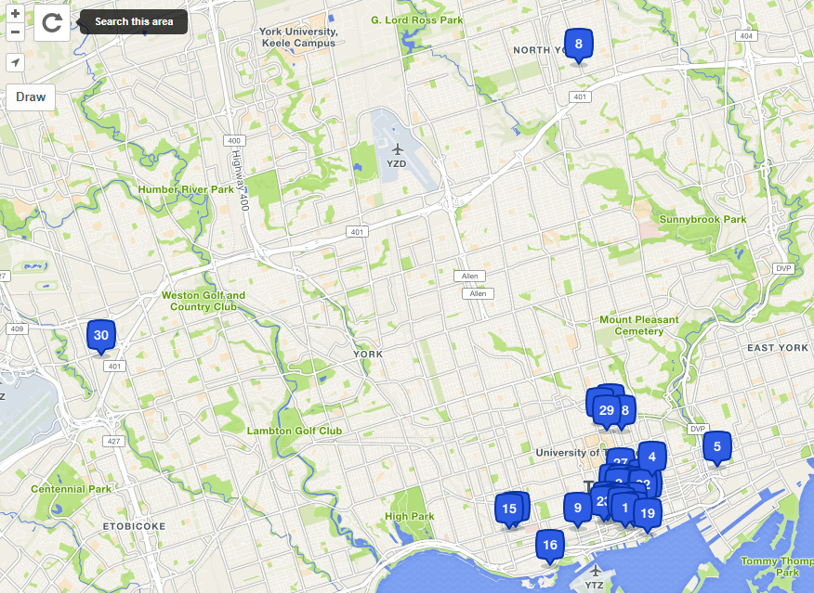
Map of Toronto, ON, Canada showing various hotels

Slide 9
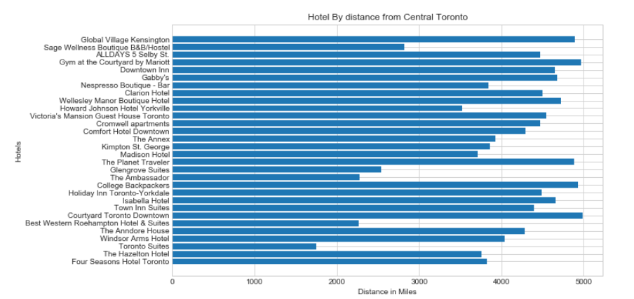
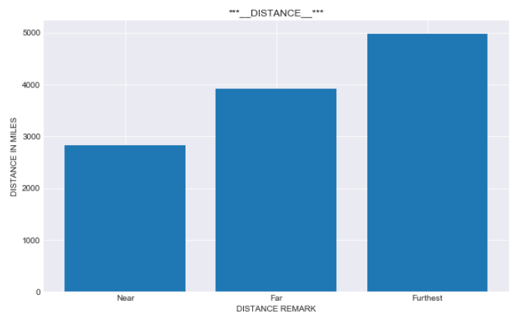
Hotels in Toronto, ON, Canada with various distance from central Town

Slide 10
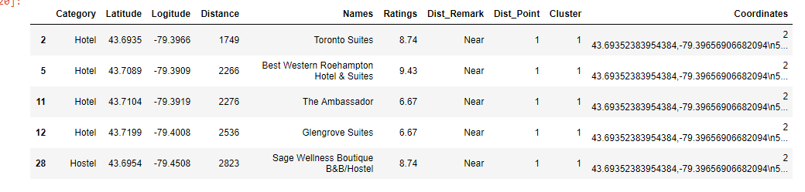
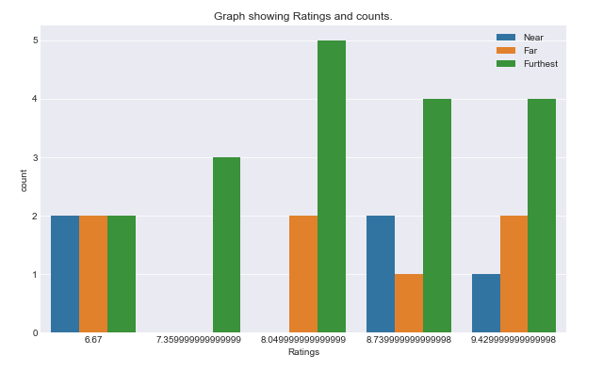
Data Frame after Clustering Algorithms have been deployed.

Slide 11
RESULT & DISCUSSION
Our analysis shows that Hotels in Toronto, Ont, Canada from The South West(lat': 43.65510995499996, 'lng': -79.478427452716) to North East ('lat': 43.74511004500005, 'lng': -79.35417254728401) we could get 30 hotels with each having a specific distance (in miles) from the Central Zone.
Equally we discovered that these hotels were rated by clients based on the Distance from Central a City
To this effect, we shall encourage XYZ Corporation to invest her resources and set up the new line of business in a location distant from the central town. We recommend that this location should be between 4000 - 5000 Miles away from the central town.
Ranges between:
Start=[43.65712, -79.37598] & Stop[43.65718, -79.37598]
Recommended Coordinates:
Lat & Long [43.6699, -79.3933]

Slide 12
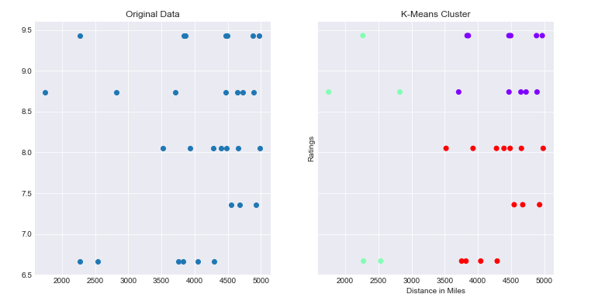
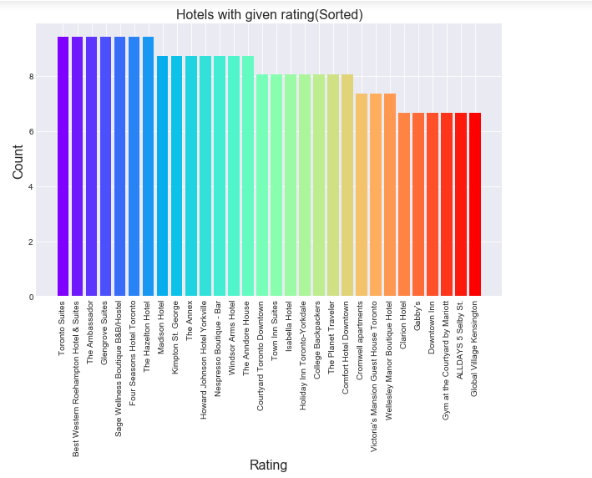

Slide 13
CONCLUSION
Purpose of this project was to identify best location where XYZ Corporation would set up a line of business(Hotel & Leisure) in Toronto, Ontario, Canada. We started by understanding the background and business need of the organization.
Next, we got into data acquisition and understand where we did some basic cleansing/preparation. We use the Foursquare API to get location data which we should used to apply methodology.
Final decision on optimal location to set up the hotel was discovered taking into account density, and nearness to central Town of Toronto based on users ratings and analytics.

Slide 14
THANK YOU!
FOR YOUR TIME
SIMON MAFANY
smafany1@gmail.com

